Slide 1
Basic Programming: Variables, Loops, If-Statements
Profs. Ivan Lee, Phillipa Gill, and Tauhidur Rahman
College of Information and Computer Sciences
Umass Amherst

Slide 2
Activity 2: Make the LED “move”
Question:
What if you want to move your LED from position #1 to position #20?

Slide 3
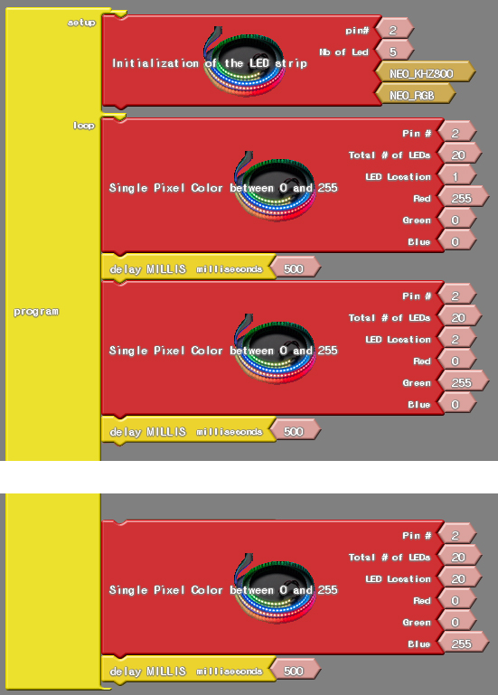
One Possible Solution
Make a “forever-long” copy-and-pastes of blocks.
…

Slide 4
One Possible Solution
Make a “forever-long” copy-and-pastes of blocks.
But this …
Takes a long time to copy and paste (what if we have 1000 LEDs?)
Not an intelligent way of programming software.

Slide 5
Can we do better?
Yes, this is what computer programming is actually designed to do!
To do this, we are going to learn about
Variable
Loops
If-statement

Slide 6
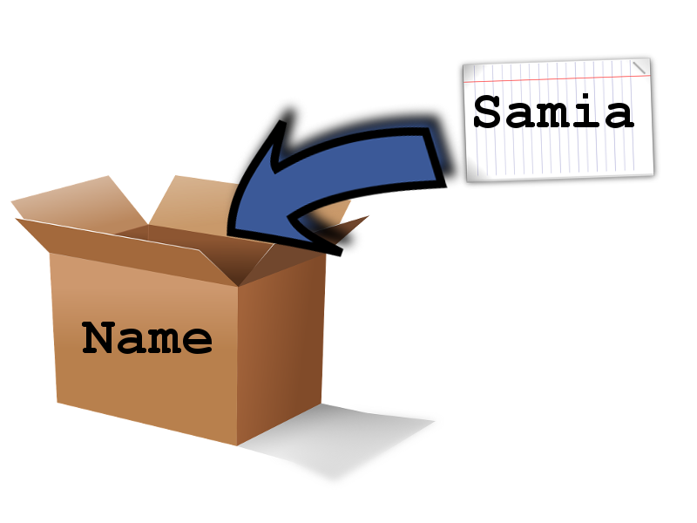
Variables
Variable is like a “box” that can store different “stuff” one at a time.
You can give a name to the “box” as well.
Stuff
Notes:
A box named “robot” can hold different robots

Slide 7
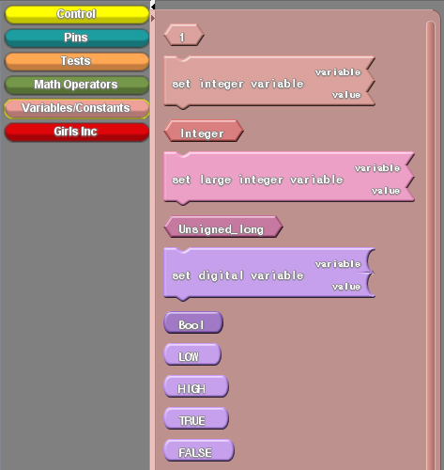
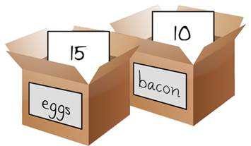
Variable
In this workshop, we will only work with boxes that can contain “integer numbers”

Slide 8
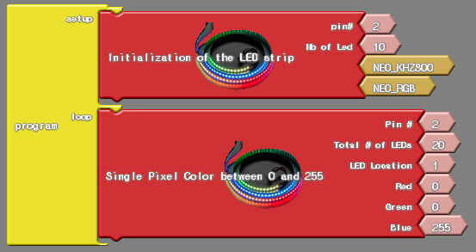
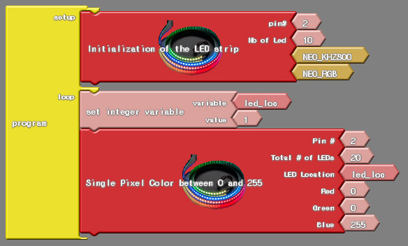
Two Programs Function Identically
Using an Integer
Using a variable

Slide 9
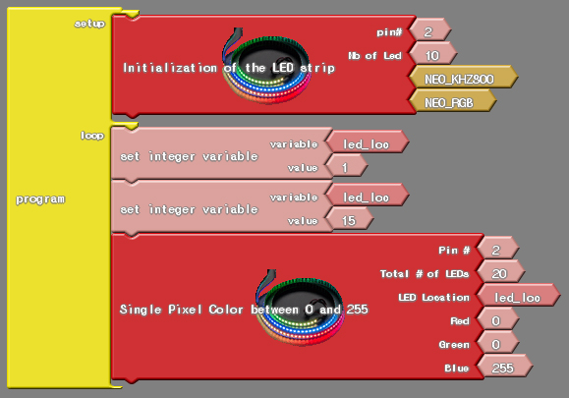
Updating Values for Variables
Which LED location will light up?

Slide 10
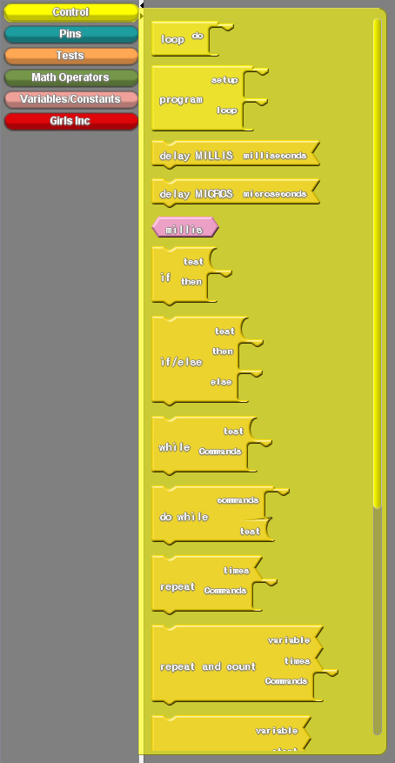
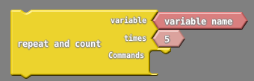
Loops
Allows you to repeat a portion of code a number of times.
Repeat and Count block allows you to
Repeat a set of code a certain number of times.
The code is iterated from #1 to #N.
The value of iteration is stored in a variable.

Slide 11
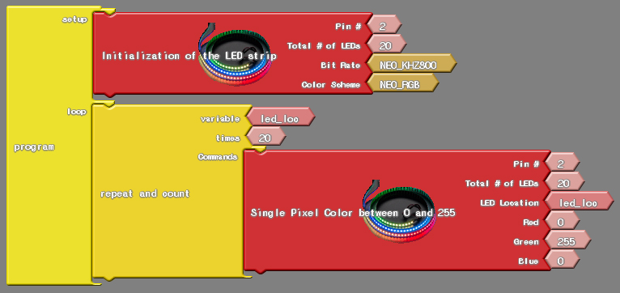
Loop
What will the following code do?

Slide 12
…

Slide 13


If-Else Statement
Check to see if certain situations are present, and perform a set of code if it is.
For example,
If “today is raining”
Then, soccer practice will be cancelled
Else
Then, soccer practice will be held

Slide 14
If-Else Statement
In ArduBlock…

Slide 15
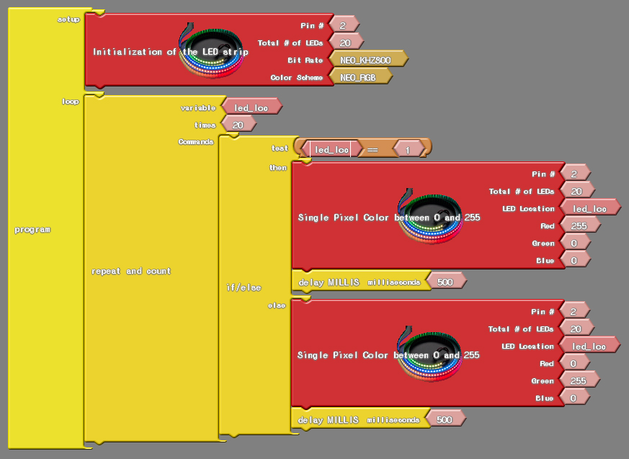
If-Else Statement
What would the following code do?

Slide 16
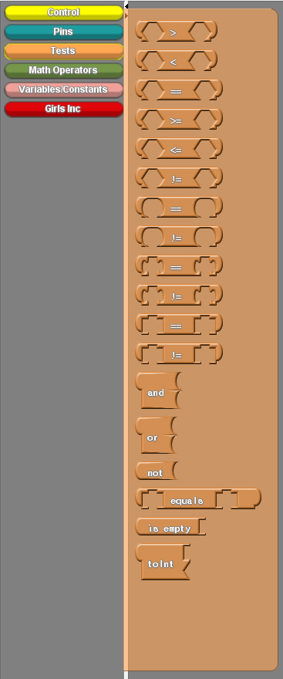
Conditions
In ArduBlock…

